Slide 1
2. Conditional Probability

Slide 2

Coins game
Toss 3 coins. You win if at least two come out heads.
S = { HHH, HHT, HTH, HTT, THH, THT, TTH, TTT }
W = { HHH, HHT, HTH, THH }

Slide 3

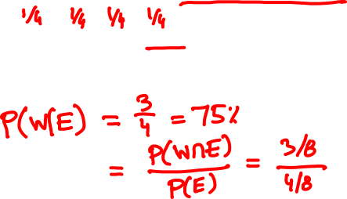
Coins game
The first coin was just tossed and it came out
heads. How does this affect your chances?
S = { HHH, HHT, HTH, HTT, THH, THT, TTH, TTT }
W = { HHH, HHT, HTH, THH }

Slide 4

Conditional probability
F
The conditional probability P(A | F) represents the probability of event A assuming event F happened.
Ω
A
Conditional probabilities with respect to the reduced sample space F are given by the formula
P(A ∩ F)
P(A | F) =
P(F)

Slide 5
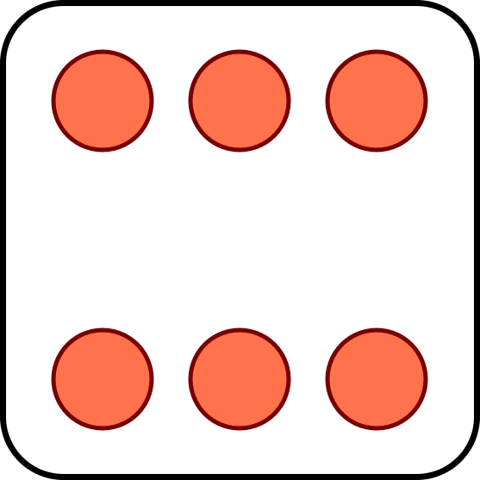
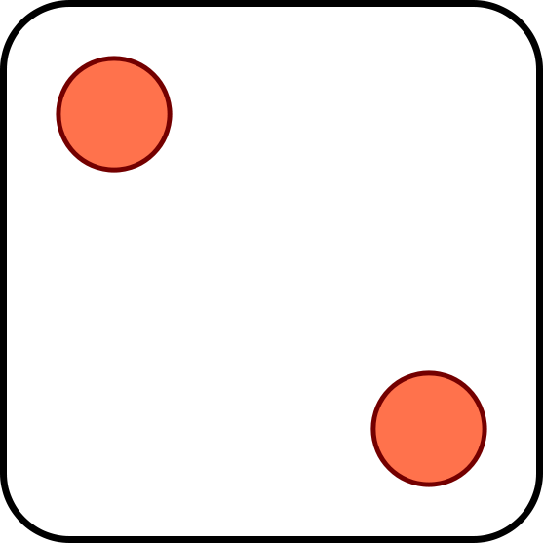


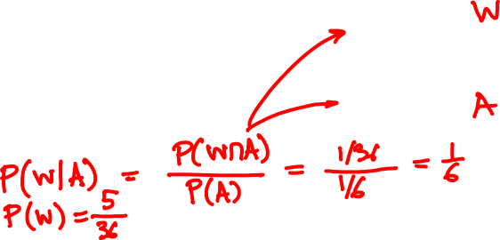
Toss 2 dice. You win if the sum of the outcomes is 8.
The first die toss is a 4. Should you be happy?
?

Slide 6
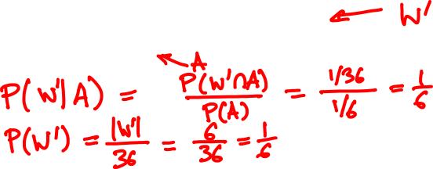
Now suppose you win if the sum is 7.
Your first toss is a 4. Should you be happy?

Slide 7
Properties of conditional probabilities
1. Conditional probabilities are probabilities:
P(F | F) = 1
P(A ∪ B | F) = P(A | F) + P(B | F) if disjoint
2. Under equally likely outcomes,
number of outcomes in A ∩ F
P(A | F) =
number of outcomes in F

Slide 8
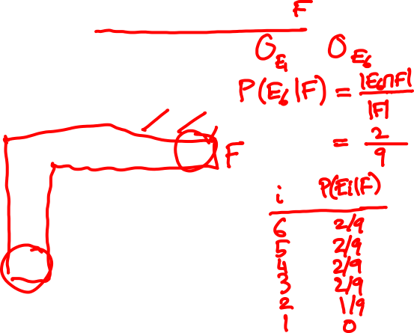
Toss two dice. The smaller value is a 2. What is the probability that the larger value is 1, 2, …, 6?
11 12 13 14 15 16
21 22 23 24 25 26
31 32 33 34 35 36
41 42 43 44 45 46
51 52 53 54 55 56
61 62 63 64 65 66

Slide 9

You draw a random card and see a black side. What are the chances the other side is red?
A: 1/4
B: 1/3
C: 1/2

Slide 10
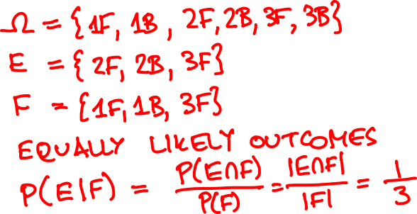

Slide 11

🇺🇸
🇨🇳
🇺🇸
🇨🇳
Serena
Williams
Qiang
Wang
Venus
Williams
Shuai
Zhang
P(Serena wins) = 2/3
P(Venus wins) = 1/2
P(🇨🇳 2: 🇺🇸 0) = 1/4
FINAL SCORE
🇨🇳
1
What is the probability
Serena won her game?
🇺🇸
1

Slide 12
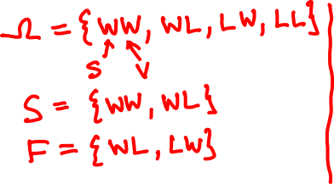

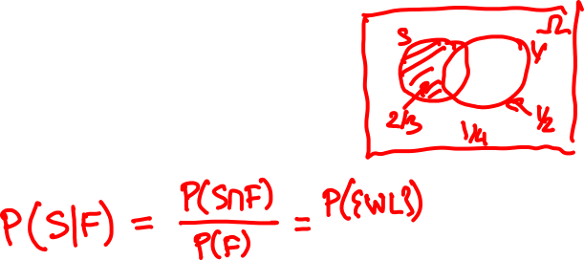
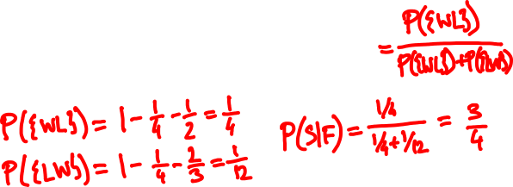

Slide 13
The multiplication rule
P(E₁∩E₂)
Using the formula
P(E₂|E₁) =
P(E₁)
We can calculate the probability of intersection
P(E₁ ∩ E₂) = P(E₁) P(E₂|E₁)
In general
P(E₁∩…∩E_{n}) = P(E₁) P(E₂|E₁)…P(E_{n}|E₁∩… ∩ E_{n-1})

Slide 14
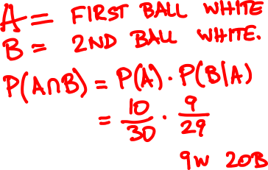
An urn has 10 white balls and 20 black balls. You draw two at random. What is the probability that both are white?

Slide 15
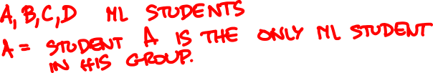
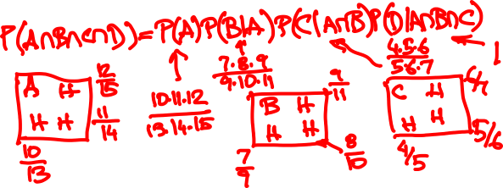
12 HK and 4 mainland students are randomly split into four groups of 4. What is the probability that each group has a mainlander?

Slide 16
Total probability theorem
F
F^{c}
P(E)
= P(EF) + P(EF^{c})
S
E
= P(E|F)P(F) + P(E|F^{c})P(F^{c})
F₃
F₁
F₄
More generally, if F₁,…, F_{n}
partition Ω then
E
F₂
F₅
P(E) = P(E|F₁)P(F₁) + … + P(E|F_{n})P(F_{n})

Slide 17
An urn has 10 white balls and 20 black balls. You draw two at random. What is the probability that their colors are different?

Slide 18
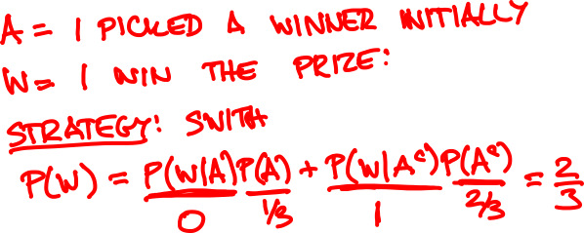
🚗

Slide 19

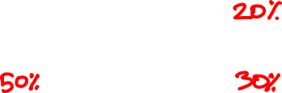
Multiple choice quiz
What is the capital of Macedonia?
A: Split
B: Struga
C: Skopje
D: Sendai
Did you know or were you lucky?

Slide 20

Multiple choice quiz
Probability model
There are two types of students:
Type K: Knows the answer
Type K^{c}: Picks a random answer
Event C: Student gives correct answer
P(C) = p = fraction of correct answers
p = P(C|K)P(K) + P(C|K^{c})P(K^{c})
= 1/4 + 3P(K)/4
1
1/4
1 - P(K)
P(K) = (p – ¼) / ¾

Slide 21
1
2
3
I choose a cup at random and then a random ball from that cup. The ball is red. You need to guess where the ball came from.
Which cup would you guess?

Slide 22

Cause and effect
1
2
3
cause:
C₁
C₂
C₃
effect:
R

Slide 23
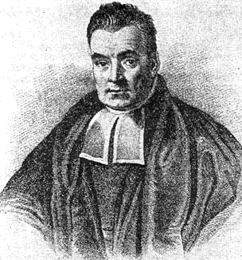
Bayes’ rule
P(E|C) P(C)
P(E|C) P(C)
P(C|E) =
=
P(E)
P(E|C) P(C) + P(E|C^{c}) P(C^{c})
More generally, if C₁,…, C_{n} partition S then
P(E|C_{i}) P(C_{i})
P(C_{i}|E) =
P(E|C₁) P(C₁) + … + P(E|C_{n}) P(C_{n})

Slide 24

Cause and effect
1
2
3
cause:
C₁
C₂
C₃
effect:
R
P(R|C_{i}) P(C_{i})
P(C_{i}|R) =
P(R|C₁) P(C₁) + P(R|C₂) P(C₂) + P(R|C₃) P(C₃)

Slide 25
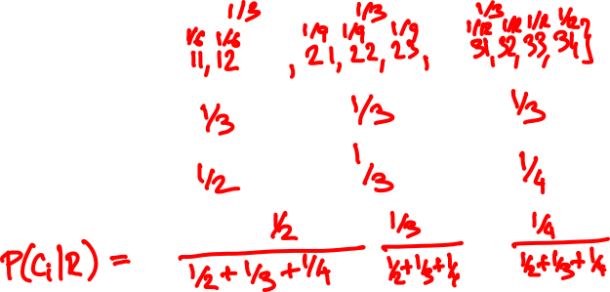
Cause and effect
1
2
3
Ω =
P(C_{i}) =
P(R|C_{i}) =

Slide 26
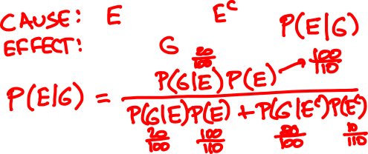

Two classes take place in Lady Shaw Building.
ENGG2430 has 100 students, 20% are girls.
NURS2400 has 10 students, 80% are girls.
A girl walks out. What are the chances that she is from the engineering class?

Slide 27
Summary of conditional probability
Conditional probabilities are used:
1
When there are causes and effects
to estimate the probability of a cause when we observe an effect
2
To calculate ordinary probabilities
Conditioning on the right event can simplify the description of the sample space

